Slide 1

Software Engineering
Bookstore Management System

Slide 2
Group Members
20141701004 Mina Melisa ALPU
20141701017 Alican ELİTOĞ
20141701037 İbrahim Semih SÖZDİNLER
20141701042 Tayyip TOPUZ

Slide 3
Contents
Purpose
Scope
Software Process Model
Requirements Analyze
Design
BMS
Testing
Future Works

Slide 4

Purpose
The goal of this project provides application for Book Store Management and this application easy to find book, selling, rent, showing daily income and supply for seller.
Main purpose of this project improving shopping activities in the book store management for customer and seller needs.

Slide 5
Scope
Fast tracking of products sale, rent, income and supply.
Provide the product storage management.

Slide 6
Software Process Model
In this project, incremental development process model is used with Agile method.
Reason of using agile method is that easier to change process to reflect changing customer requirements.

Slide 7
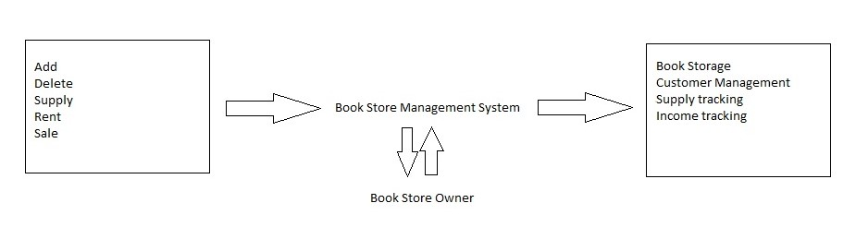
User Requirements

Slide 8
System Requirements
Functional Requirements
Add/Delete
Sale
Rent
Income
Supply
Customer
Search
Non-Functional Requirements
Product Requirement
Organizational Requirements
External Requirements

Slide 9
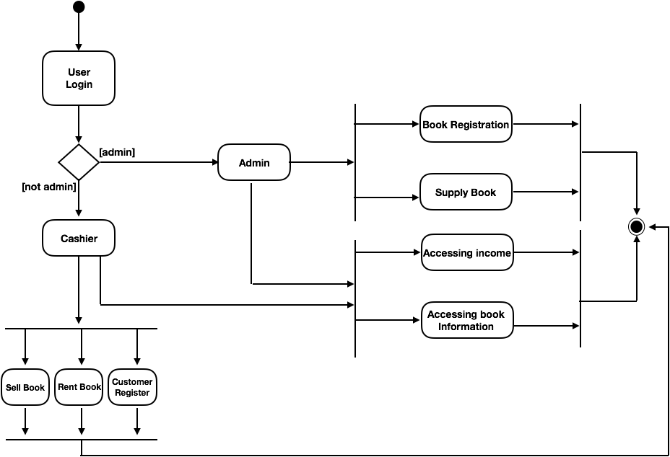
Design
Activity Diagram

Slide 10
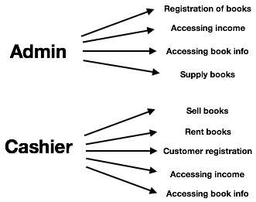
Design Cont.
Use Case Diagram

Slide 11
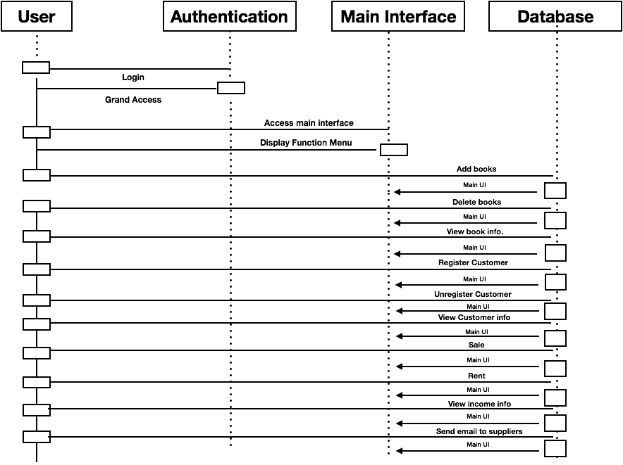
Design Cont.
Sequence Diagram

Slide 12
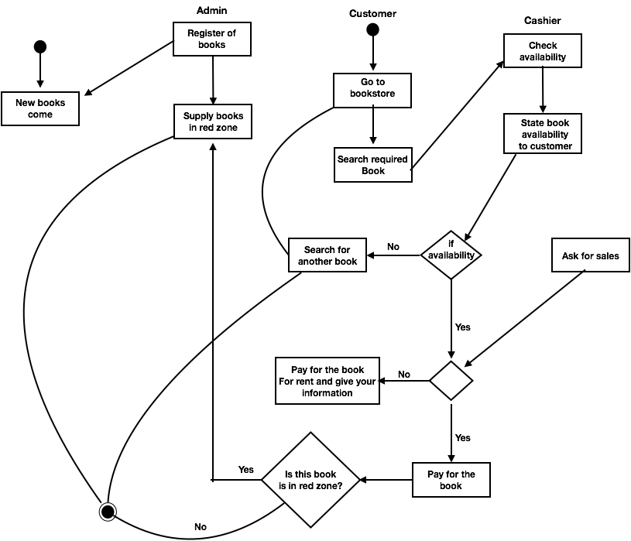
Design Cont.
State Diagram

Slide 13
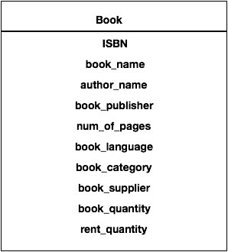
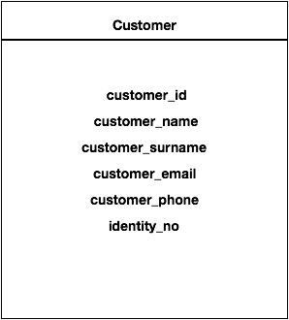
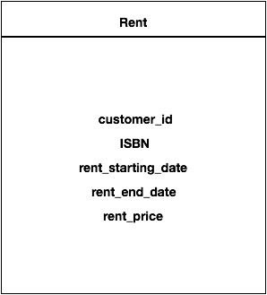
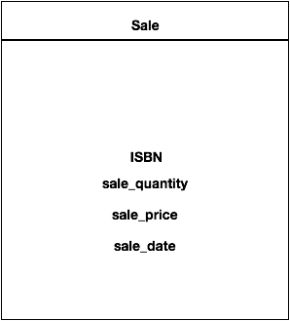
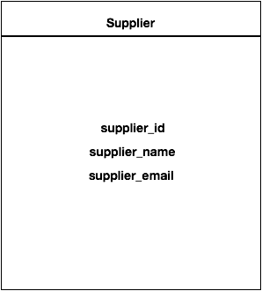
Design Cont.
Class Diagram

Slide 14
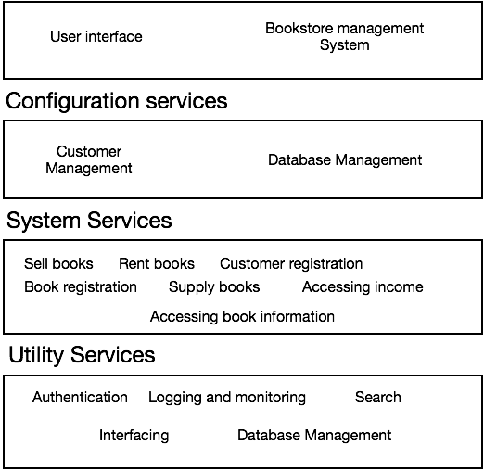
System Architectural Design

Slide 15
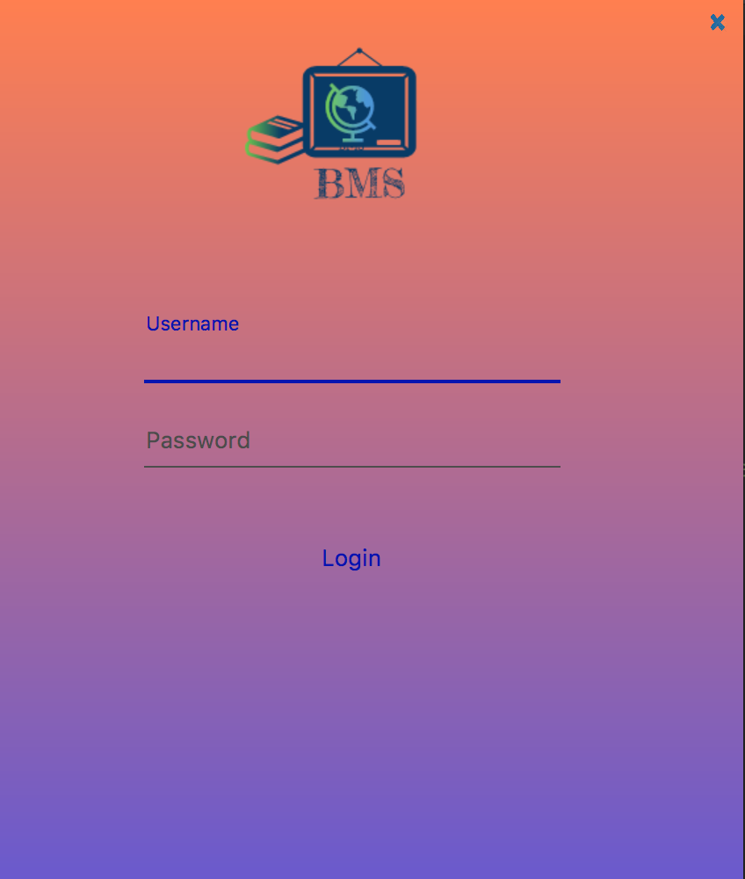
Bookstore Management System

Slide 16
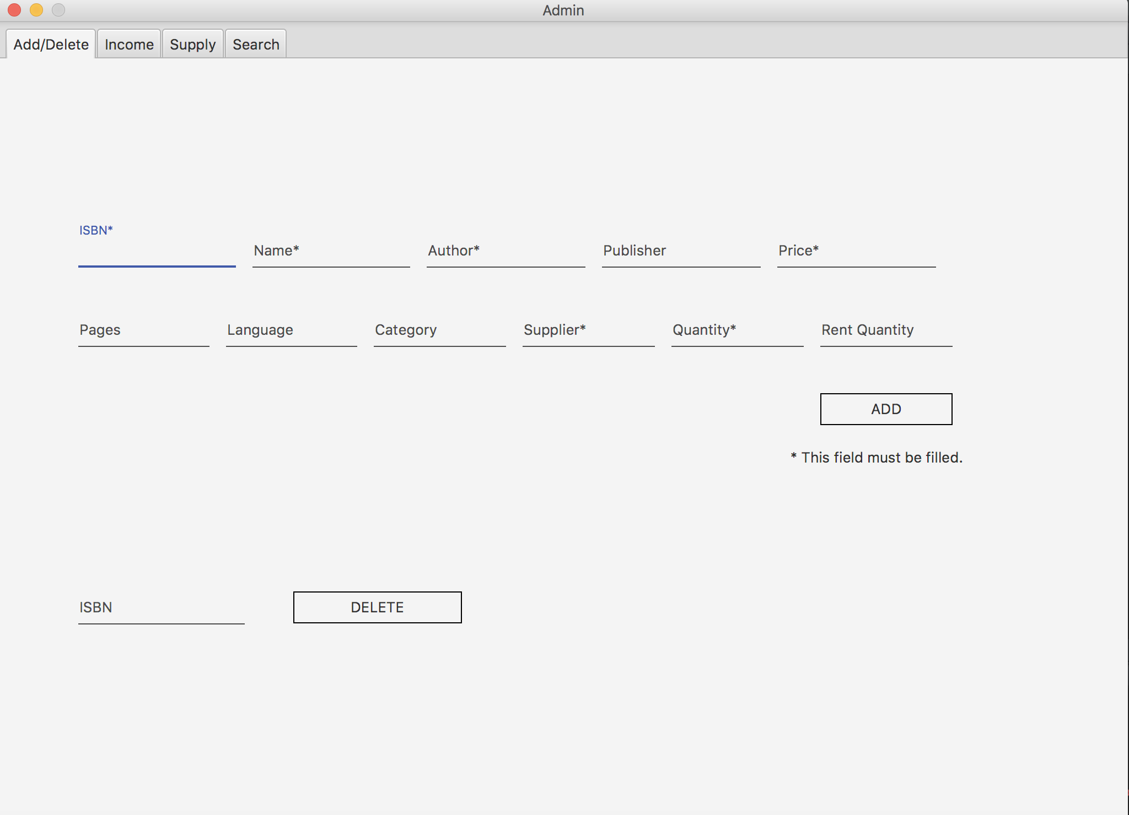
Admin Interface
Add/Delete

Slide 17
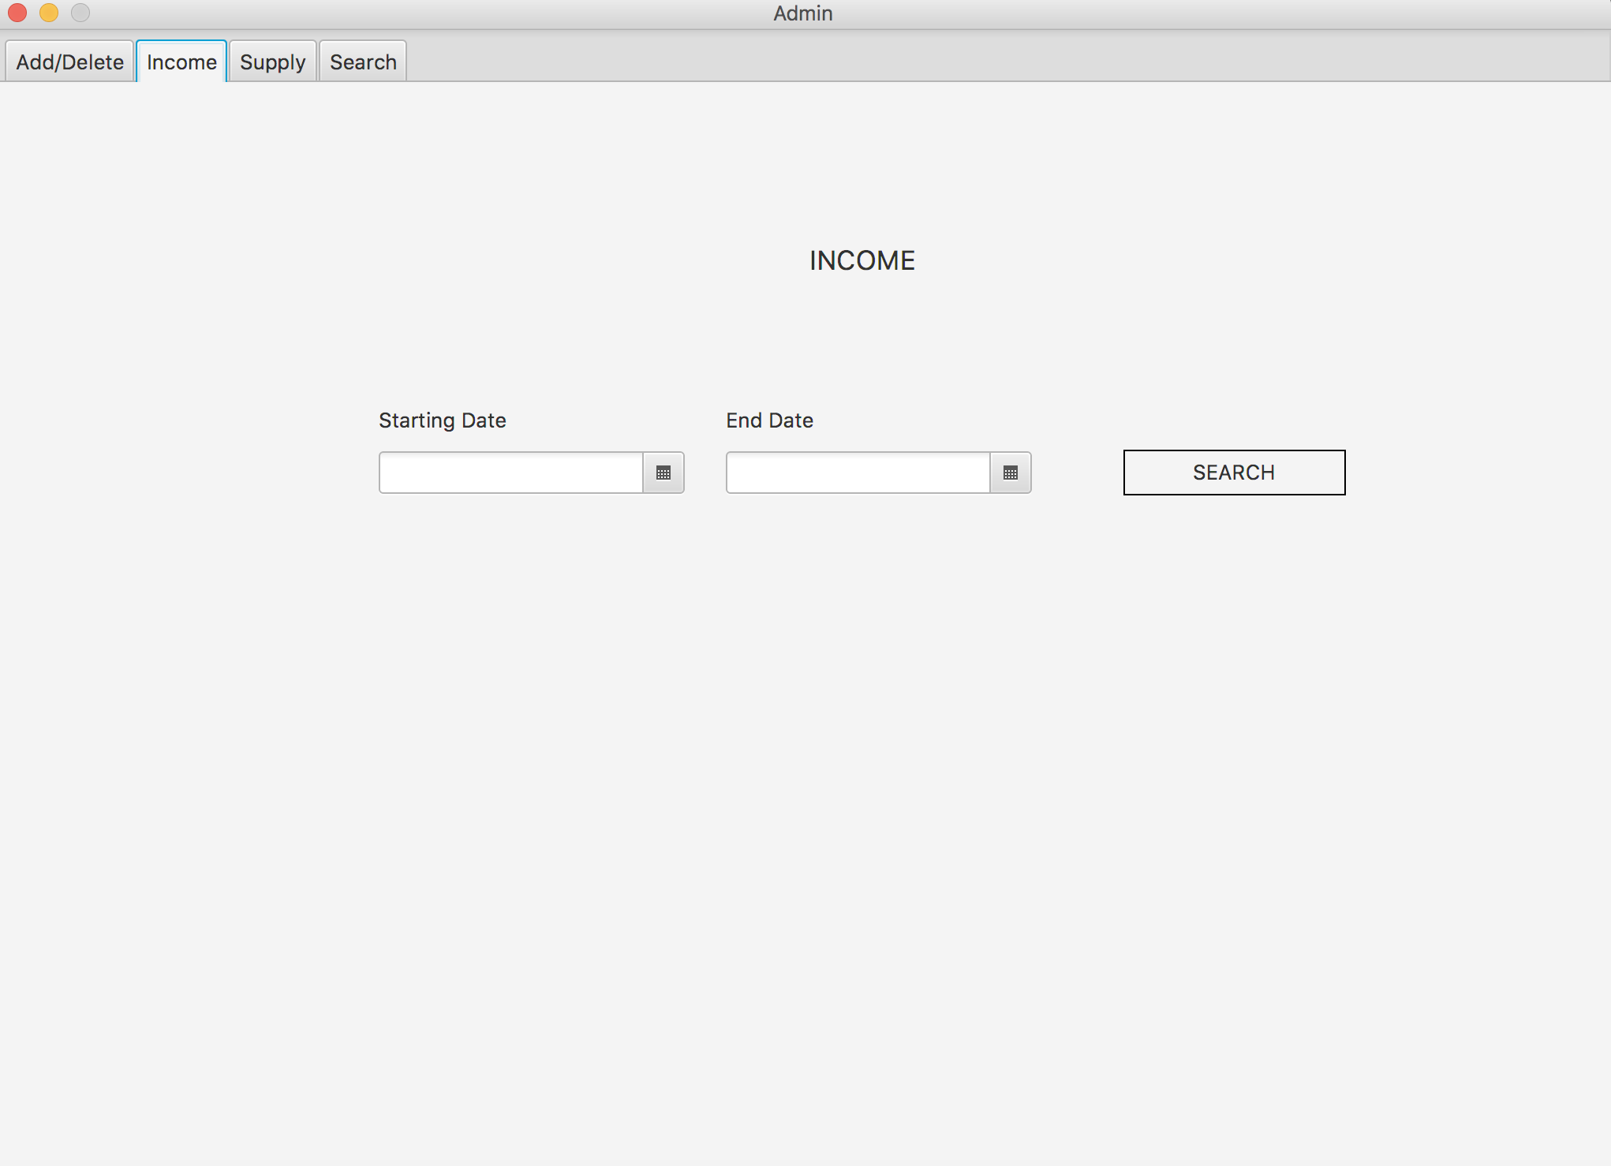
Admin Interface
Income

Slide 18
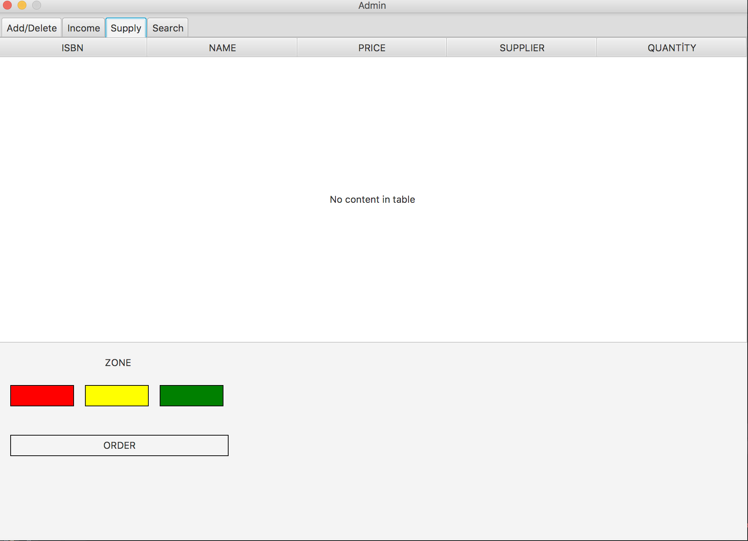
Admin Interface
Supply

Slide 19
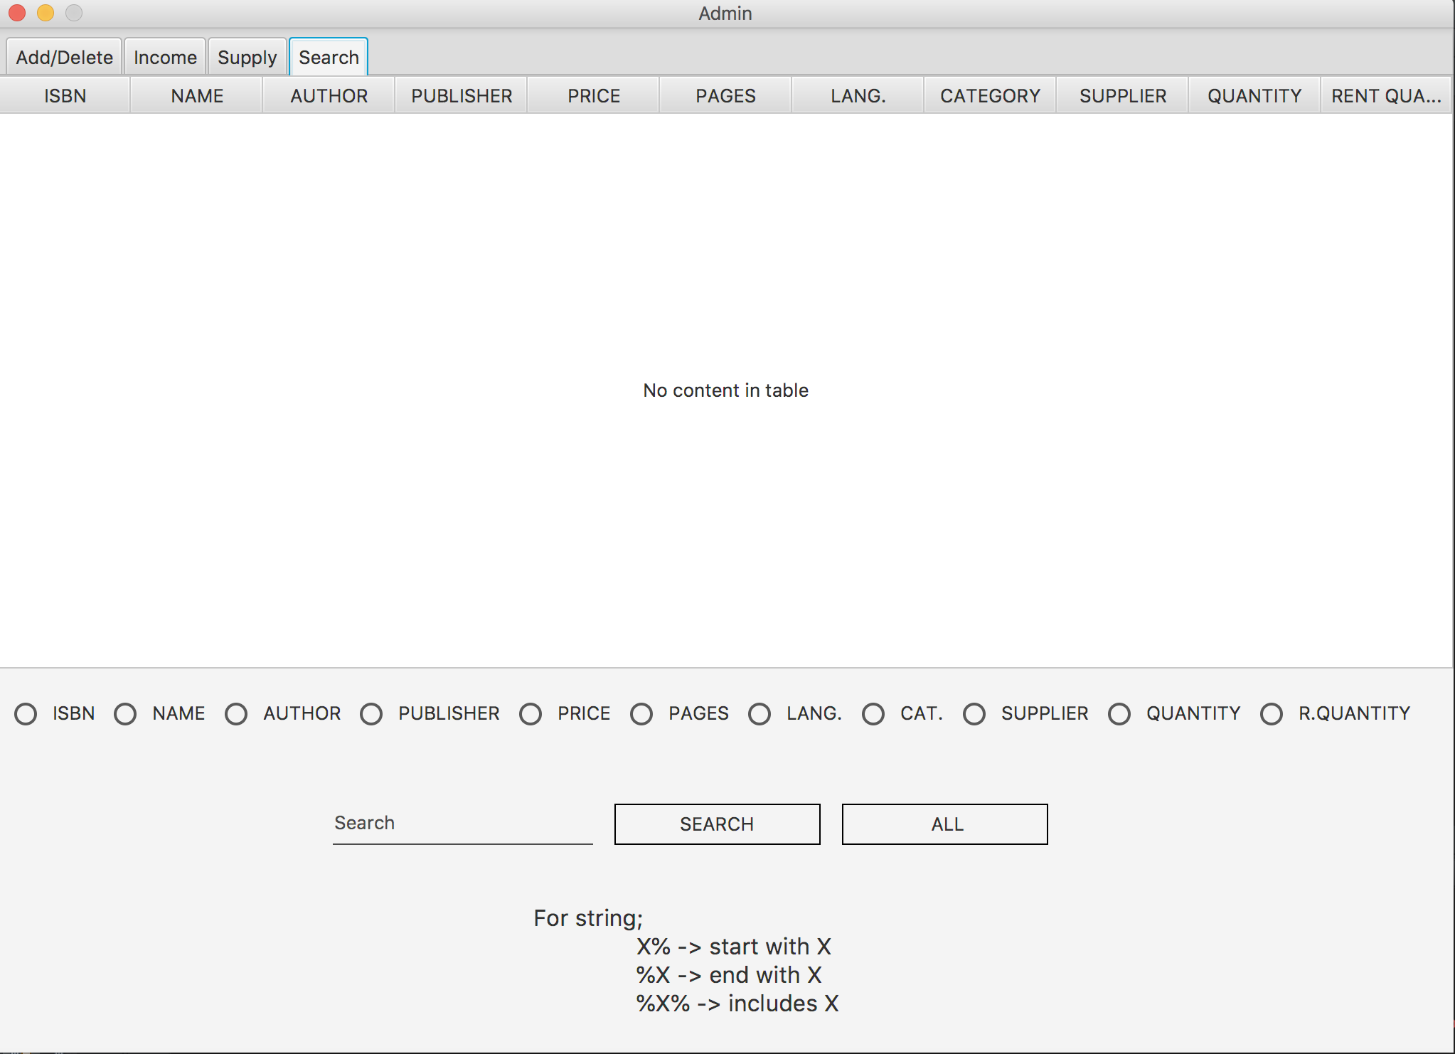
Admin Interface
Search

Slide 20
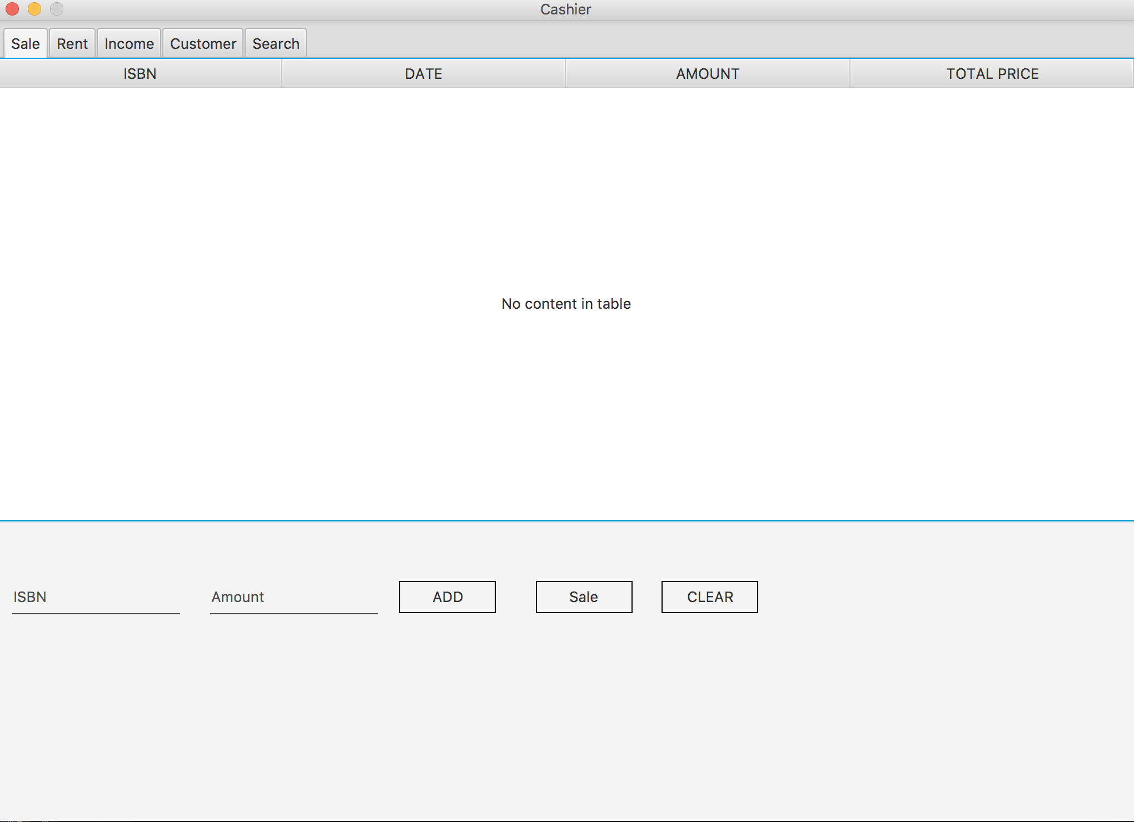
Cashier Interface
Sale

Slide 21
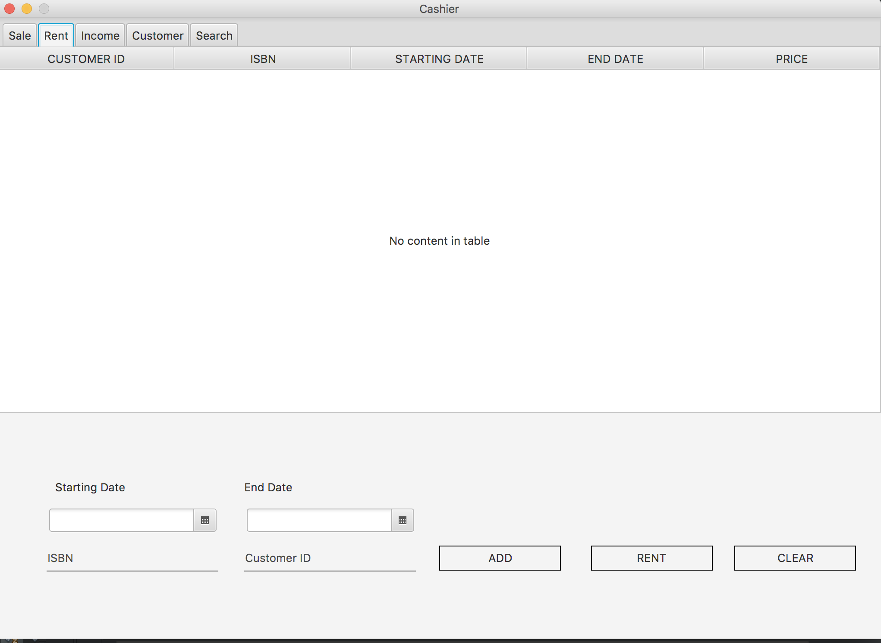
Cashier Interface
Rent

Slide 22
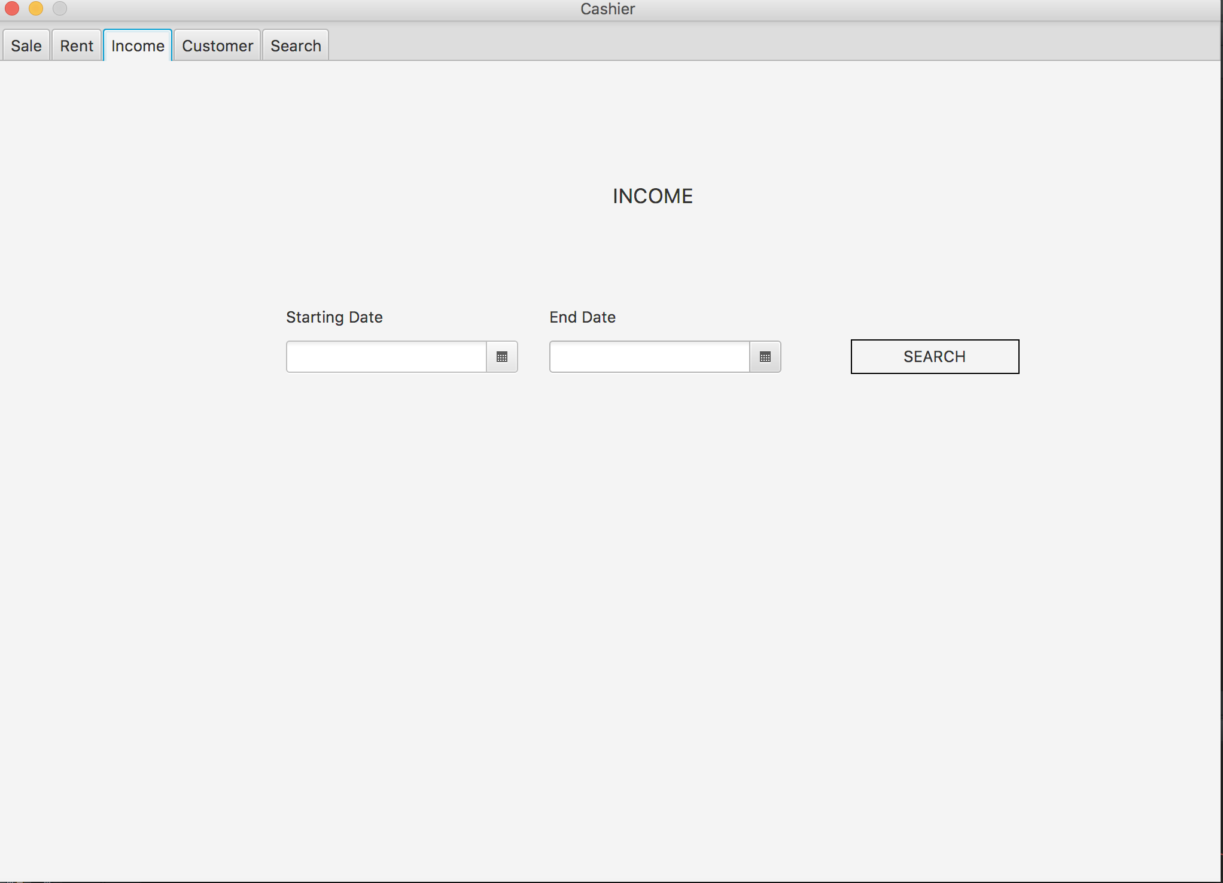
Cashier Interface
Income

Slide 23
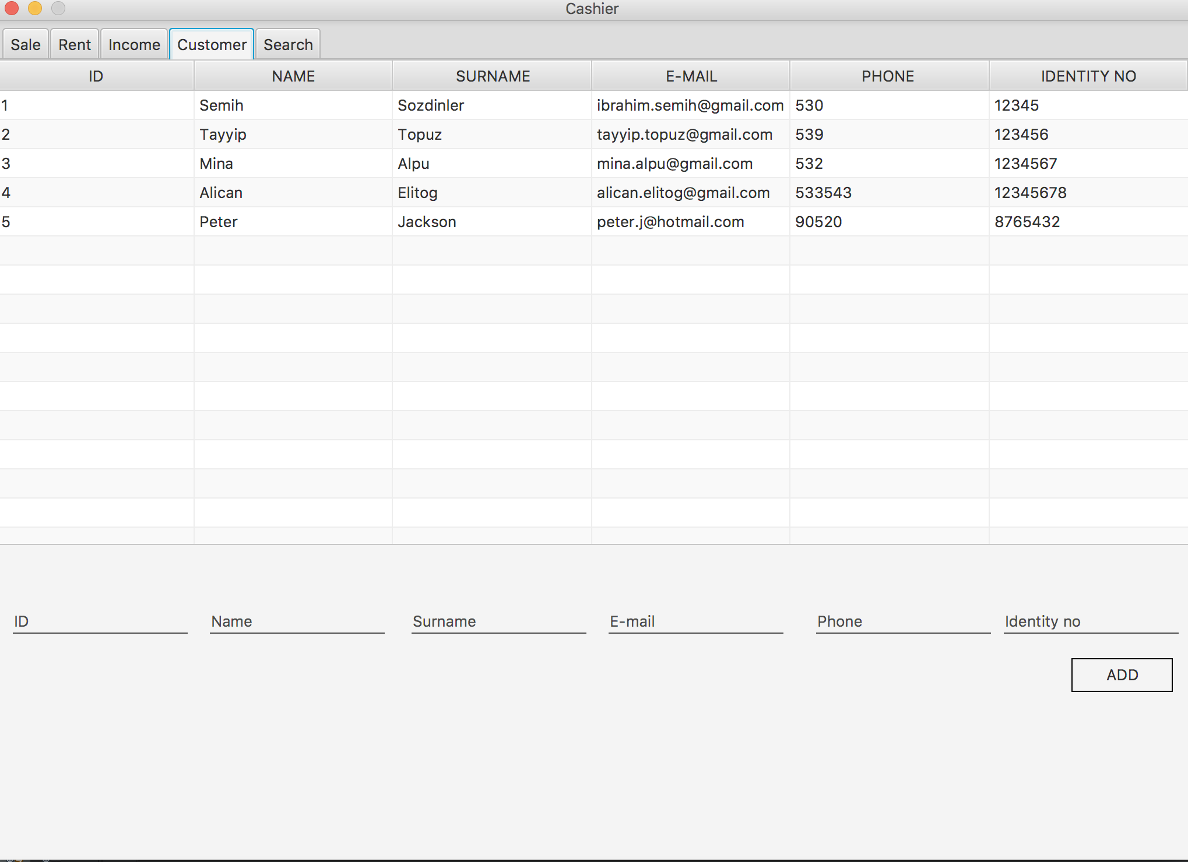
Cashier Interface
Customer

Slide 24
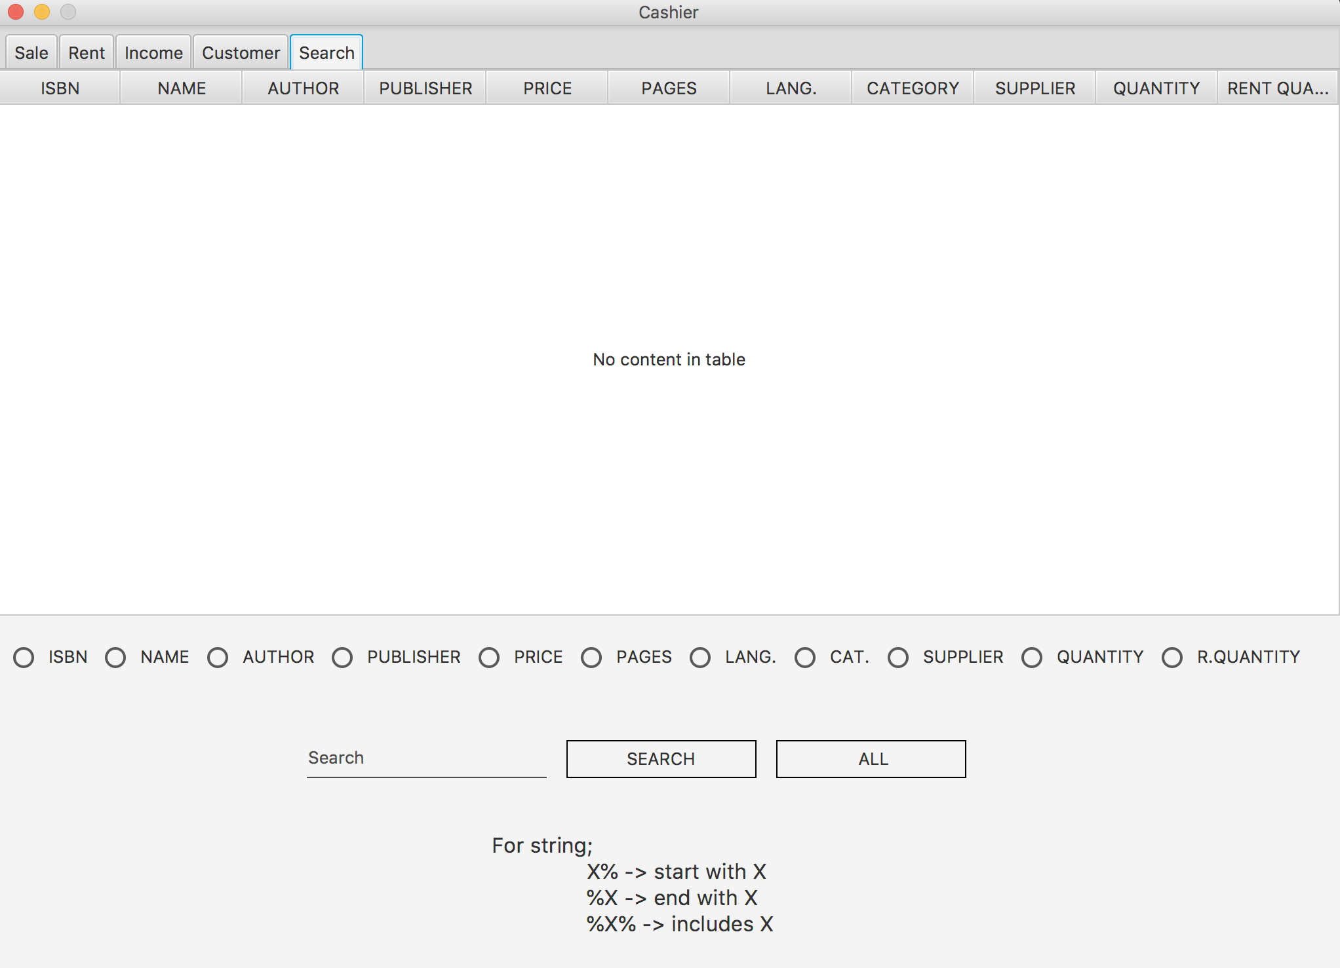
Cashier Interface
Search

Slide 25
Testing
Data fields bug If any of data fields blanked out, there occur error in background.
Zone order bug When clicked the buttons two or more times, orders are copied pushed times.

Slide 26
Future Works
Solving bugs
System control from Internet
Directly order via e-mail.
Reusability of system
Order selection
Addition and deletion user

Slide 27


